Slide 1

Computer Programming for Engineers
Week 7 Lecture 1
Oct. 11, 2022
Lecturer: Mohammad Mahdi Javidan
College of Engineering, Sungkyunkwan University
Fall Semester 2022

Slide 2
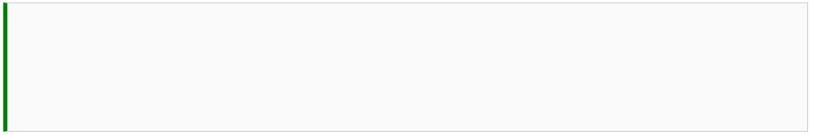
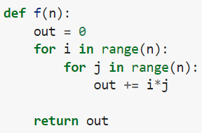
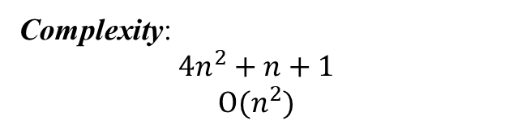
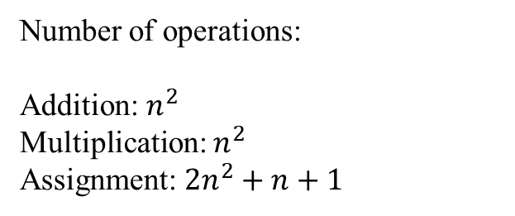
Complexity
Number of operations:
Addition: $n^{2}$
Multiplication: $n^{2}$
Assignment: $2n^{2}+n+1$
Complexity:
$$4n^{2}+n+1$$
$$O(n^{2})$$
College of Engineering, Sungkyunkwan University

Slide 3
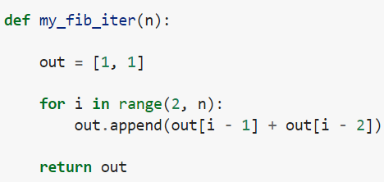
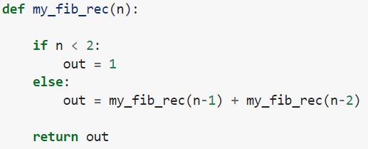
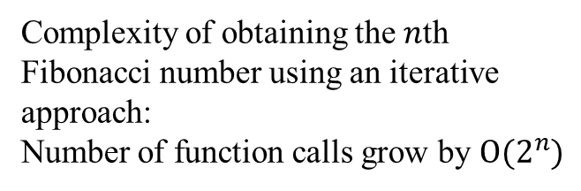
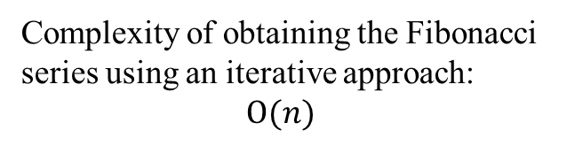
Complexity
Complexity of obtaining the Fibonacci series using an iterative approach:
$$O(n)$$
Complexity of obtaining the $n$th Fibonacci number using an iterative approach:
Number of function calls grow by $O(2^{n})$
College of Engineering, Sungkyunkwan University

Slide 4
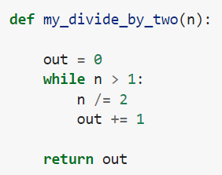
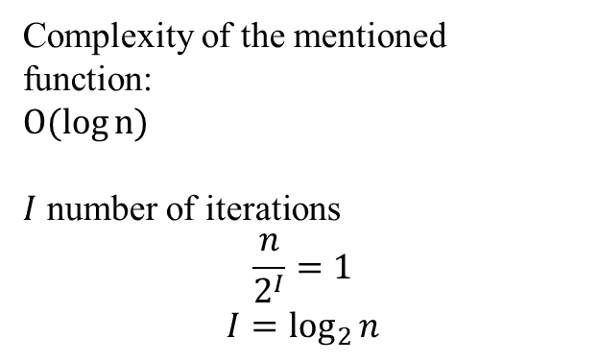
Complexity
Complexity of the mentioned function:
$O(\log{n})$
$I$ number of iterations
$$\frac{n}{2^{I}}=1$$
$$I=\log_{2}{n}$$
College of Engineering, Sungkyunkwan University

Slide 5
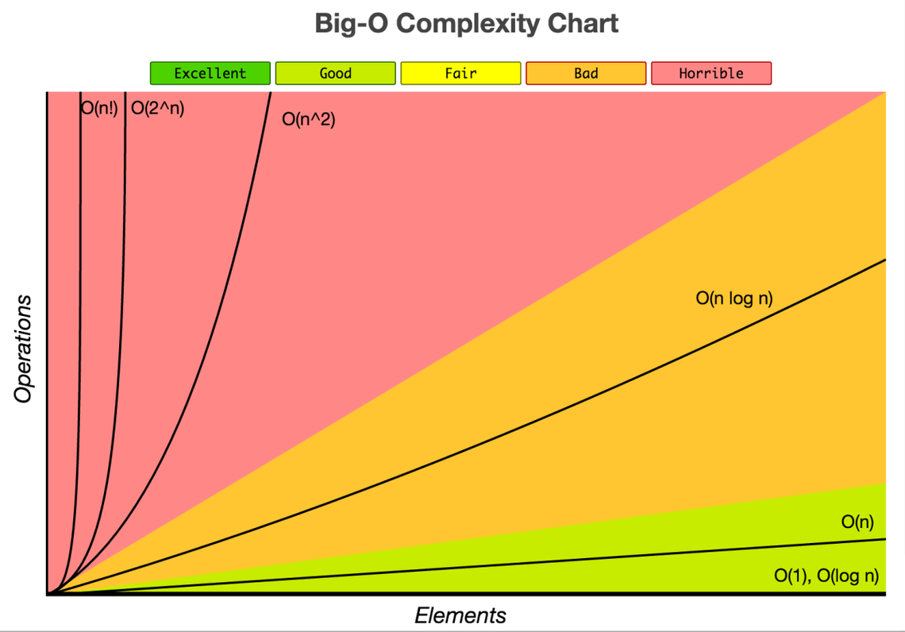
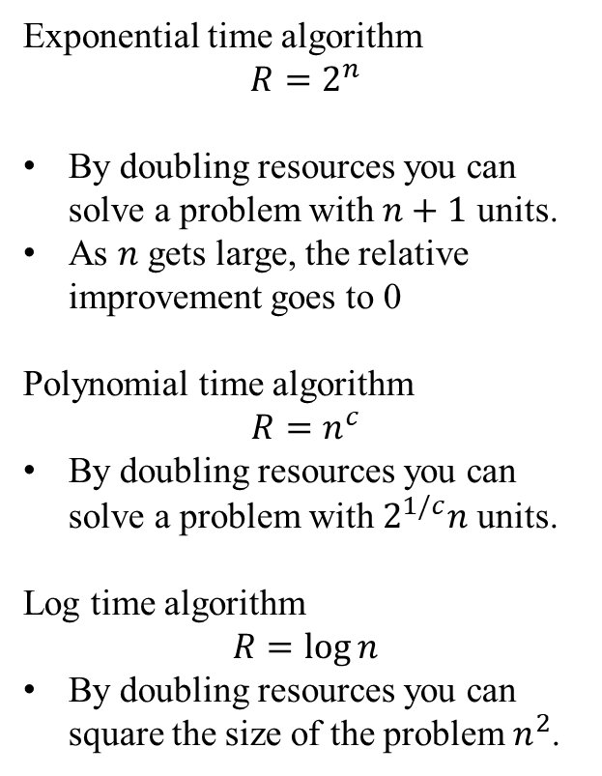
Complexity
Exponential time algorithm
$$R=2^{n}$$
By doubling resources you can solve a problem with $n+1$ units.
As $n$ gets large, the relative improvement goes to 0
Polynomial time algorithm
$$R=n^{c}$$
By doubling resources you can solve a problem with $2^{1/c}n$ units.
Log time algorithm
$$R=\log{n}$$
By doubling resources you can square the size of the problem $n^{2}$.
College of Engineering, Sungkyunkwan University

Slide 6
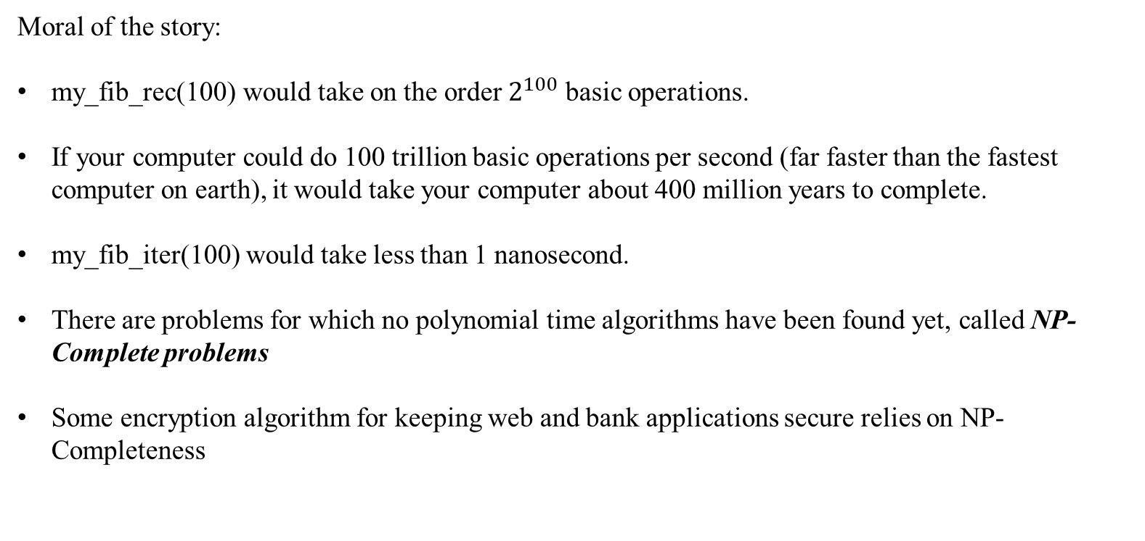
Complexity
Moral of the story:
my_fib_rec(100) would take on the order $2^{100}$ basic operations.
If your computer could do 100 trillion basic operations per second (far faster than the fastest computer on earth), it would take your computer about 400 million years to complete.
my_fib_iter(100) would take less than 1 nanosecond.
There are problems for which no polynomial time algorithms have been found yet, called NP-Complete problems
Some encryption algorithm for keeping web and bank applications secure relies on NP-Completeness
College of Engineering, Sungkyunkwan University

Slide 7
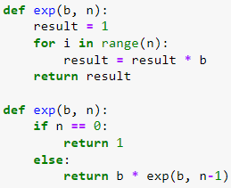
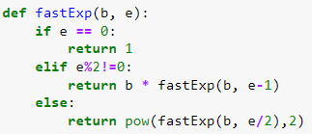
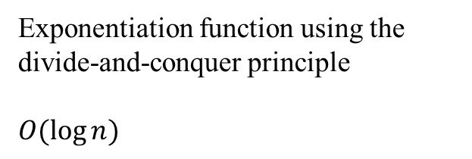
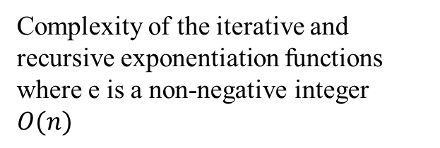
Complexity
Complexity of the iterative and recursive exponentiation functions where e is a non-negative integer
$O(n)$
Exponentiation function using the divide-and-conquer principle
$O(\log{n})$
College of Engineering, Sungkyunkwan University

Slide 8


Profiler
Profile: a set of statistics describing how often and for how long various parts of the program executed
Execution time:
User time: processing the code, loops, conditions, branches, etc.
CPU time: system calls, output, input and the kernel code
Real, wall-clock or elapsed time: total time spent, including waiting for the execution of the program
College of Engineering, Sungkyunkwan University

Slide 9

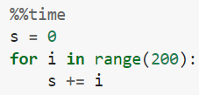

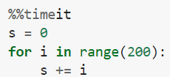
Profiler
Execution time of small snippets
Using double percent magic command for measuring the time for a whole cell
College of Engineering, Sungkyunkwan University

Slide 10
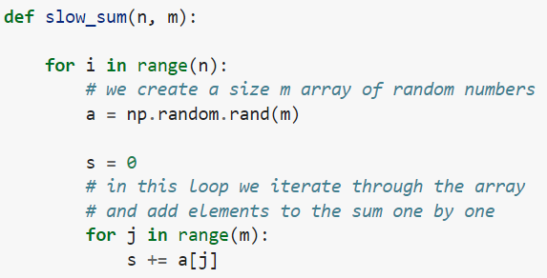

Profiler
Install it using
pip install line-profiler
College of Engineering, Sungkyunkwan University

Slide 11
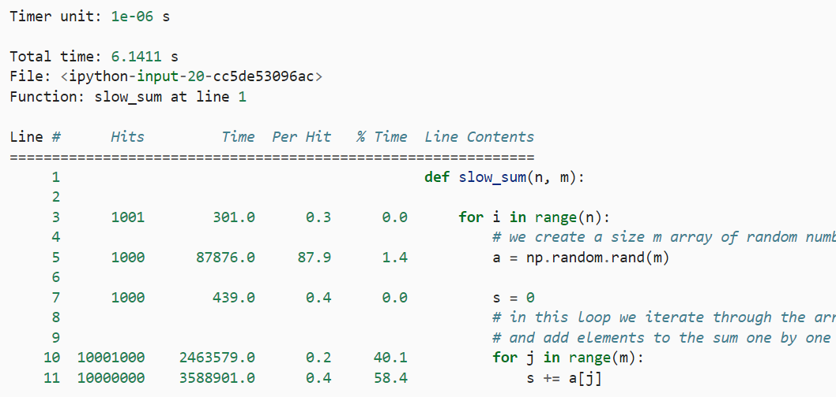
Profiler
College of Engineering, Sungkyunkwan University

Slide 12
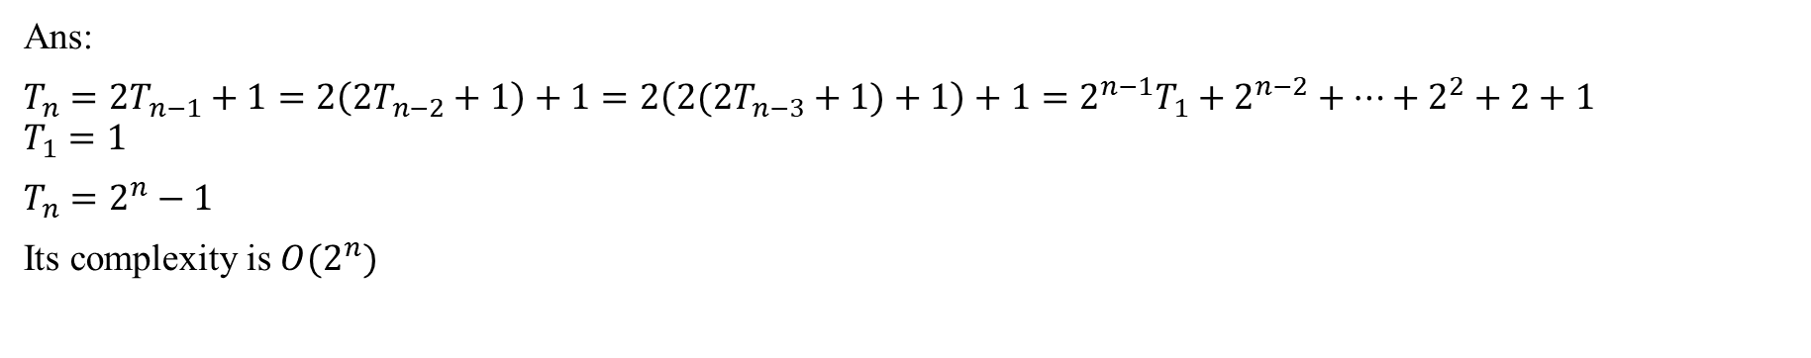
Question!
What is the Big-O complexity of the Towers of Hanoi problem?
Ans:
$T_{n}=2T_{n−1}+1=2\left(2T_{n−2}+1\right)+1=2\left(2(2T_{n−3}+1)+1\right)+1=2^{n−1}T_{1}+2^{n−2}+…+2^{2}+2+1$ $T_{1}=1$
$T_{n}=2^{n}−1$
Its complexity is $O(2^{n})$
College of Engineering, Sungkyunkwan University

